Slide 1
The Real Estate Problem
ADVANCED QUANTITATIVE METHODS FOR BUSINESS
Kuntal Ghosh
Craig DeBono
Priyanka Kalmane
Hanqing Gong
Lichong Xia

Slide 2
Agenda
Introduction
Executive Summary
Problem Statement
Motivation
Data
Problem
Recommendations
Insight

Slide 3
Introduction
Real Estate Company
Would you like to live in a place with high air quality?
Would you prefer a place where a car is not needed?
How about a place with low taxes?
We specialize in finding your dream location!
Notes:
Investing in real estate is becoming a common investing method. When people make the decision of investing in real estate, especially for those non-first time buyers, they usually value different factors
other than prices or house conditions. They might have considerations such as the costs and benefits
to rent the house or live in the house after they retired. They might consider other factors such as neighborhood environment or taxation rates. For some environmentalist, they might also consider the CO2 emissions since it contributes the most to climate change.
In this project, we studied how each factors we collected effects the real estate investing decisions and we came up with the optimum investing suggestions.

Slide 4
Executive Summary
Who?
  Real estate company that has environmentally conscious clients
What?
  Seeking optimal way to locate housing areas for clients
Why?
  Home buyers do not have sufficient information when purchasing a home
How?
  Solutions found through advanced quantitative optimization techniques

Slide 5
Problem Statement
Locate the 10 best housing areas in the United States
Factors:
CO2 Levels
Housing Values
Income Per Household
Elevation
Income Tax
Property Tax
Vehicle Miles
Population Density

Slide 6
Motivation
Business perspective
Speedier housing search process
More details for customer
Easily adjust concerns to allow for new location options
Providing these features will increase revenue

Slide 7
Data Sources
Data gathered from the following sources:
UC Berkeley Research (CoolClimate)
  Mapped the average CO2 amount by zip code
  Study findings
    Areas with high/low CO2 Levels
State Tax Rates
Property Tax Averages

Slide 8
Data Pre-Processing
Cleaning, Filtering and Scaling of data
The data obtained from CoolClimate required some pre-processing before we could build the model:
Cleaning: Reduced dataset from 28 columns to 11 columns
Filtering: Chose top 50 zip codes based on lowest CO2
Scaling: Made factors comparable by decimal scaling
Data usability improved by cleaning, filtering and scaling the data
Notes:
Data originally contained 28 cols, reduced to 11 (zip, city, state and 8 factors)
Filtered out 50 records with lowest CO2 levels (to reduce complexity of optimization model)
The values of various factors scaled to make them comparable

Slide 9
Problem Formulation
Optimization problem with the following characteristics
Decision variables:
  Every Zip Code
    Value of 1 given to those selected
    Select exactly 10
Cost Function:
  Gives cost(penalty) associated with each zip code
  Minimizes total cost
  Sums weighted values of the 8 different factors
Factors/Values
Factor | Optimum Value | Remarks
Population density | 4000 persons/sq. mile | Non-linear relation
Average House Value | $100,000 | Non-linear relation
Income | $50,000 yearly | Non-linear relation
Income Tax | 0.0% | Lower the better
Property Tax | $0 | Lower the better
Elevation | 0 feet above sea level | Lower the better
Vehicles miles traveled | 0 miles | Lower the better
Total CO2/Year | 0 metric tons | Lower the better
Notes:
Associated one binary decision variable with each one of the 50 areas (x1 through x50)
We will try to select exactly 10 of these variables as a solution
Formulate a cost function by adding the weighted values of the 8 factors
We want optimal values for some factors, as a result we consider the difference between the value of that factor and an optimal value
Eg. desired_popden = absolute(popden-4000)
Others we want to minimize as much as possible eg total co2 or income tax

Slide 10
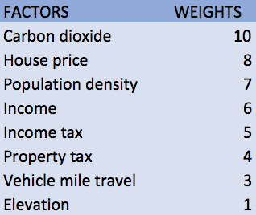
Solution Method – Business Perspective
Formulating the cost function by weighting each factor
Evaluate importance of each factor from a customer’s perspective
Prioritize factors based on their relative importance
Assign a weight between 1 and 10, to each factor, based on its importance
Carbon dioxide (most important) - weight of 10
Elevation (least important) - weight of 1

Slide 11
Solution Method – Technical Perspective
Cost function – Non linear function:
  Cost = Decision Variable (Binary) * ( 7*Population Density + 8*Average House Value + 6*Income + 5*Income Tax + 4*Property Tax + 1*Elevation + 3*Vehicles Miles Travelled + 10*CO2/Year )
Optimization technique – Non linear programming
Constraints
  Decision variables are binary
  Exactly 10 decision variables will have values equal to 1
Application used to solve : MS Excel Solver
Optimization technique : GRG Non-linear Programming
Nonlinear Optimization by minimizing total weighted cost of factors

Slide 12
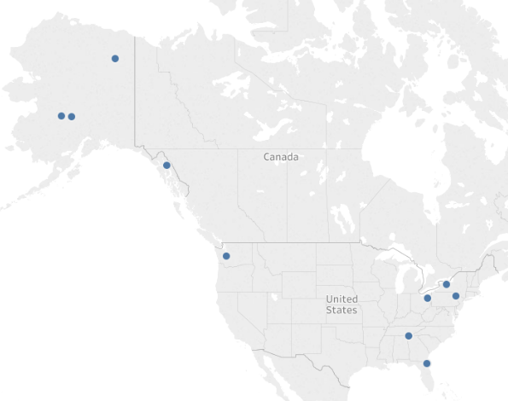
Results
Based on our Optimal solution, the following cities were chosen
State | City | Zip code
New York | Rochester | 14604
Alaska | Takotna | 99675
Alaska | Nikolai | 99691
Pennsylvania | Scranton | 18503
Ohio | Akron | 44308
Alaska | Arctic Village | 99722
Alaska | Juneau | 99850
Florida | Jacksonville | 32202
Washington | Tacoma | 98402
Tennessee | Chattanooga | 37402

Slide 13
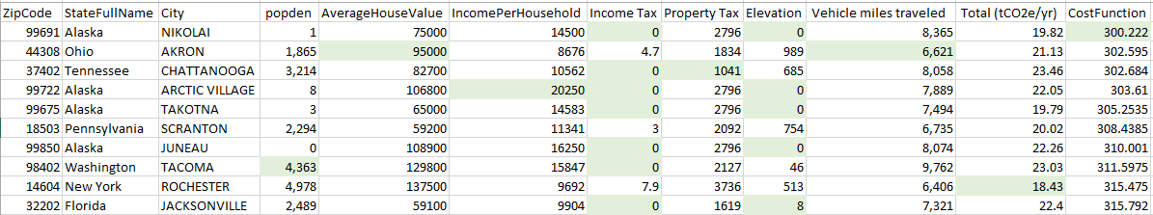
Results
Area Statistics

Slide 14
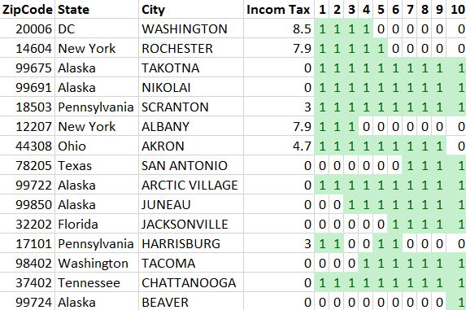
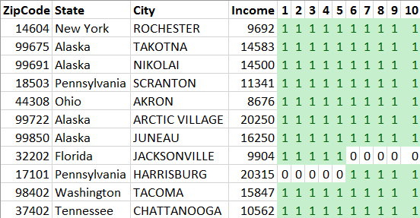
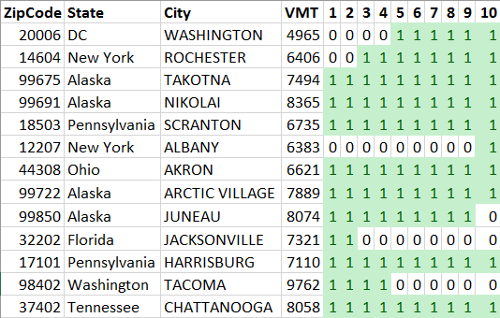
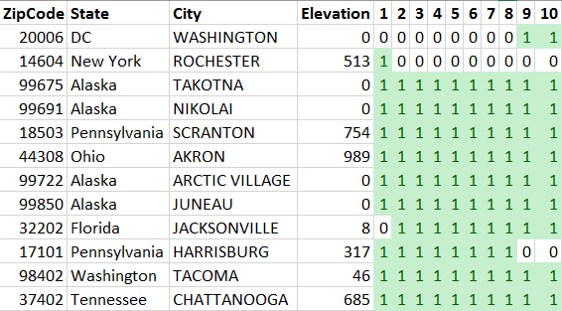
Sensitivity Analysis
Income
Tax
Income
1
Selected
0
Not Selected
Vehicles Miles Travelled
Elevation
Notes:
Sensitivity analysis to measure the impact of each factor on the decisions
Weights of each factor varied between 1 and 10 keeping the weights of all other factors constant
Only the affected areas are kept in these reports
Some show a lot of variations with change in weight (eg.Income Tax, VMT)
Others show minimal impact on the decisions (eg. Income)

Slide 15
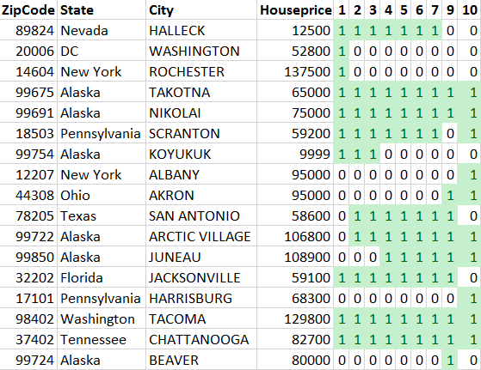
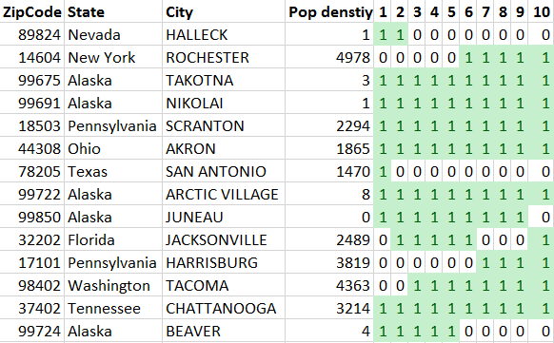
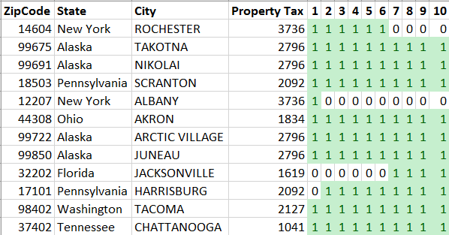
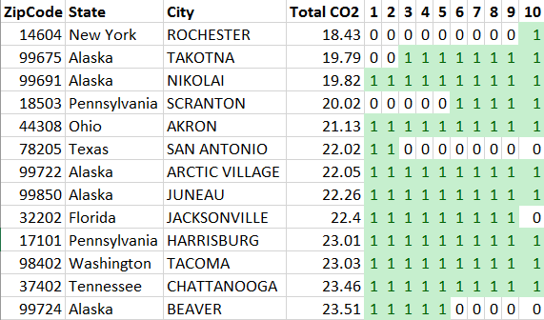
Sensitivity Analysis (contd.)
House price
Population density
1
Selected
0
Not Selected
Total
CO2
Emission
Property
Tax
Notes:
House price shows lot of variation in decision with change in weight
One of the Alaskan regions (Takotna) moves out of our decision once the weight of the total CO2 is reduced

Slide 16
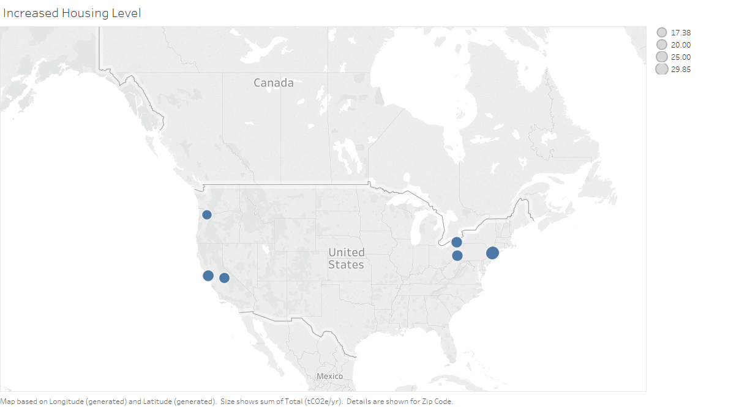
Further Insights
Average House Value
House value range
  $200K to $ 1 million
Increased CO2 levels
Increased Average Income
Decreased Vehicle Miles
Notes:
Altered the filtration criteria to select zip codes with house values between 200K & 1million
Ran program using same cost functions to get the following areas of interest
CO2 levels had much higher values, avg income was higher and miles traveled values decreased

Slide 17
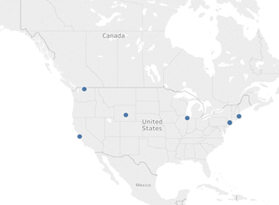
Further Insights
Income Based Analysis
Analysis on top 50 cities having an income between 75,000 – 125,000 sorted based on lowest CO2
General Observations and Comparative analysis:
  Higher CO2 values
  Higher population density
Trade off - Higher income may mean higher CO2!

Slide 18
Impact
Provides customers with a useful instrument to make correct real estate investing decisions
Focus on environmentally conscious customer and their views about evaluating a buying decision
Tool to assign different weights by how important different factors are in their real life and as a real estate company, providing more reasonable suggestions
Provide customers with information to make an educated choice
Notes:
Provides your customers with an instrument to make an educated choice

Slide 19
Sources
UC Berkeley Data
http://coolclimate.berkeley.edu/
Income Tax Rates & Property Tax average
http://modernsurvivalblog.com/retreat-living/lowest-to-highest-taxes-by-state/

Slide 20
Thank You
Questions?

